Slide 1
ONLINE GROCERY SHOPPING APP
Submitted By:
Himanshu Pundir
Shivam Sharma
Amit Jaiswal
SUBMITTED TO DR. SHASHANK BHARDWAJ

Slide 2
Introduction
Online grocery shopping is a way of buying food and other household necessities using a web-based shopping service. There are two basic methods that people can use to purchase these items online. One is to order them from a local grocery store that participates in online shopping. A customer can then arrange for a home delivery directly from the store, or he can pick up his order at the store once an employee has assembled it. Another common practice is to order groceries from a large company, such as Amazon or Net grocer, that will ship the items to one’s home.
Online markets have been a thing that has come to stay with the society of today since most financial transactions can be attained online. Internet access has vastly grown across the world today and has given rise to interconnectivity even to the remotest areas in the world. This generally means it is possible to be at any location and reach any other location in the world without stepping a foot out of your premises. This takes multi-tasking to another level since you can be in a meeting and visit a market located several kilometers away at the same time. This has made businesses to grow without spending as much as they would have if they had to build another branch of their business in another location. Groceries are different from many other products, such as music and books, that are commonly purchased online. Many grocery products are perishable and therefore time-sensitive in terms of their delivery needs.

Slide 3
Technologies Requiements
Android mobile devices (All companies like Samsung, Google, Oneplus)
Code Editor: Android Studio
Front End: Java, Kotlin, Xml
Back End: PHP, Microsoft MySQL Server 2019
Intel i5 or above processor
8Gb RAM or above
Hard-Drive capacity 512GB or above

Slide 4
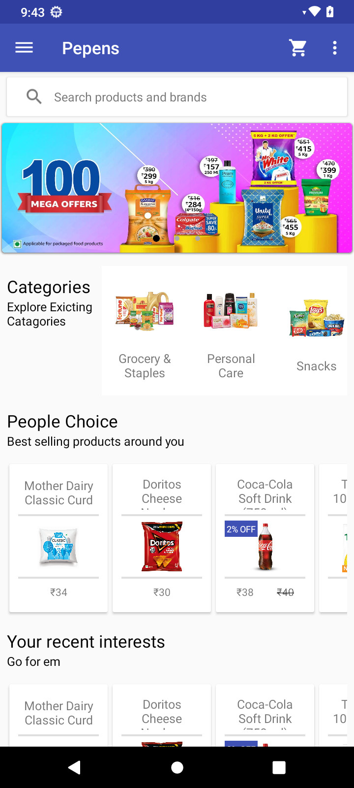
App Home Screen
On the app home screen you will get multiple promotional banner’s where you can get information about latest deals and offer and after that you have different categories and products listings as per recommendation.

Slide 5
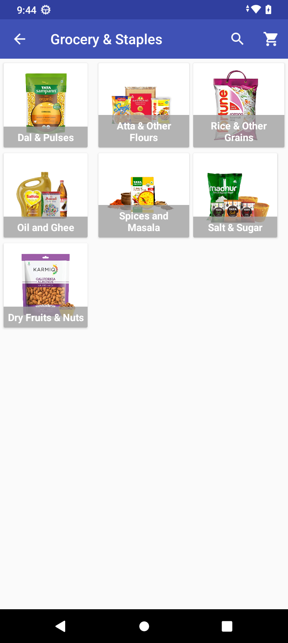
Category Screen
Inside categories screen you will get listing of different categories like Smartphone, Accessories etc. This screen will helps you to find products in a categories way.

Slide 6
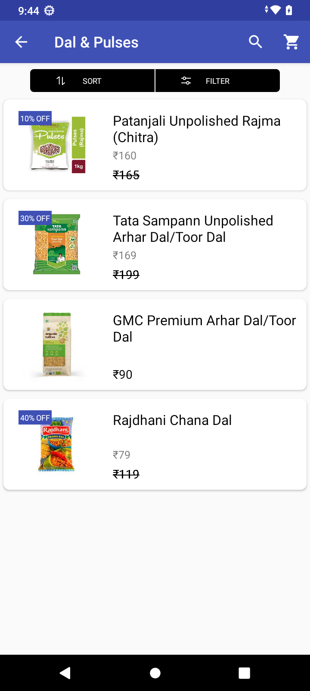
Product Listing Screen
Product listing screen will help you to find list of all products of a category like if you choose smartphone category on this screen you will get all products or items list for that category.

Slide 7
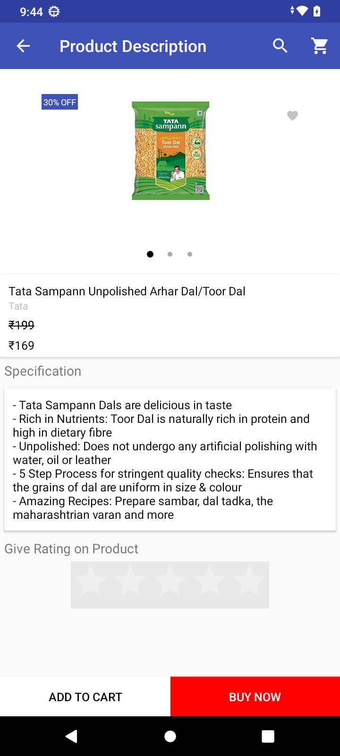
Details Screen
Product details screen will help you to find all specific details of any product and from the details screen you can add product to cart and buy them.

Slide 8
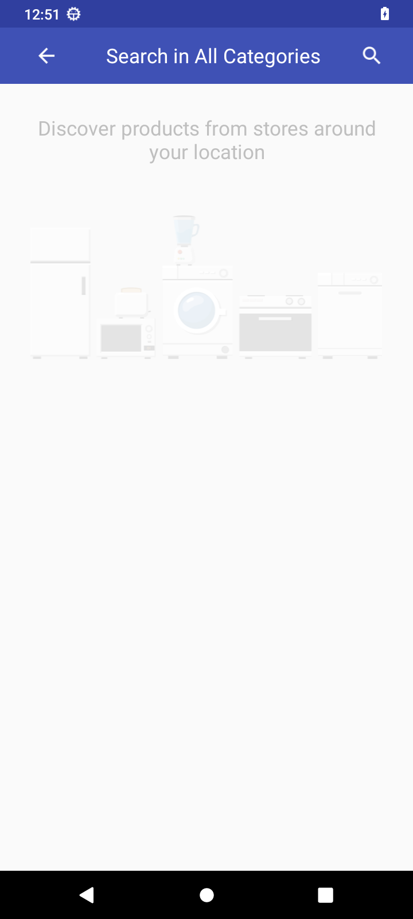
Search Screen
Search screen is an important role in the application by using search you can find any product without scrolling between different screens. This screen will save time for users.

Slide 9
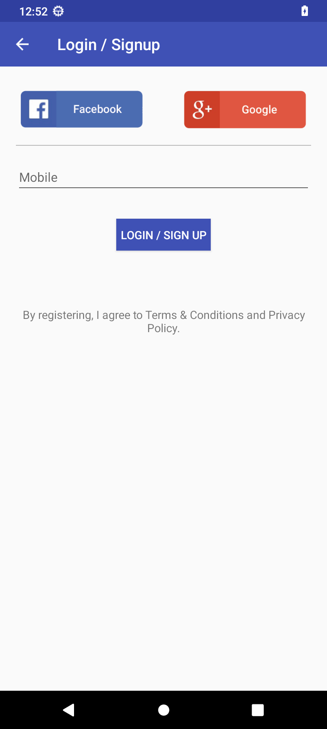
Login Screen
Login screen is an most important feature of any application. I’ll help our system to organise every user and therir shopping products and other users specific features.

Slide 10
Upcoming features
Shopping cart screen
Orders screen and order details screen
Profile section

Slide 11
Conclusion
Grocery shopping app will help users to order daily need products on their device from home, they don’t need to get out for shopping. This system also save the user time and provide flexibility to shop anywhere and anytime.

Slide 12
Thanks

